Slide 1


Computational and Experimental Design Single Cell Analysis Program (SCAP) Workshop
September 23-27, 2024
Kilifi, Kenya

Slide 2
Computational track
Monday
Module 1 - pre-processing
Module 2 - quality control, normalization
Project time
Tuesday
Module 3 - cell subsets, differential expression, cell annotation
Module 4 - batch correction, integration
Project time
Wednesday
Module 5 – immune repertoires
Project time
Thursday
Project time
Friday
Project presentations

Slide 3
Module 2 - quality control and normalization
Working with count matrices:
Basics of bioinformatics tool-kits in omics research.
Quality control and normalization starting from gene count matrices.
Interacting with single-cell data in R: Seurat objects.

Slide 4
Basics of bioinformatics tool-kits in omics research.
Programming languages
R
python
package environments
Bioconductor
scverse

Slide 5
Basics of bioinformatics tool-kits in omics research.
Programming languages
R
python
package environments
Bioconductor
scverse
“Backbone” packages
Seurat / SingleCellExperiment
scanpy / anndata

Slide 6
Basics of bioinformatics tool-kits in omics research.
Programming languages
R
python
package environments
Bioconductor
scverse
“Backbone” packages
Seurat / SingleCellExperiment
scanpy / anndata
specialized packages
scRepertoire
scirpy

Slide 7
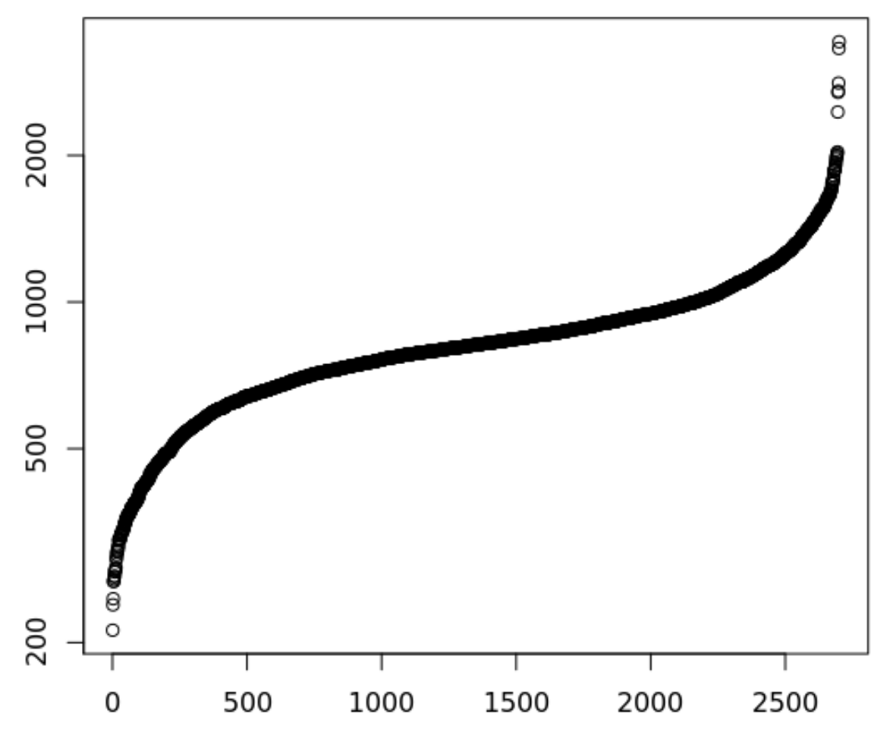
There are many quality control filters for genes and cells
Genes detected per cell (ordered)
Complexity =
Number of genes detected in a cell
Complexity
Complexity
Cell
Notes:
Filtering both ends. Lower: Failed libraries? Higher: Doublets?
Outlier cells are not just measured by complexity
•Percent Reads Mapping
•Percent Mitochondrial Reads
•Presence of marker genes
•Intergenic/ exonic rate
•5' or 3' bias
•other metadata …
•Useful Tools
Picard Tools and RNASeQC

Slide 8
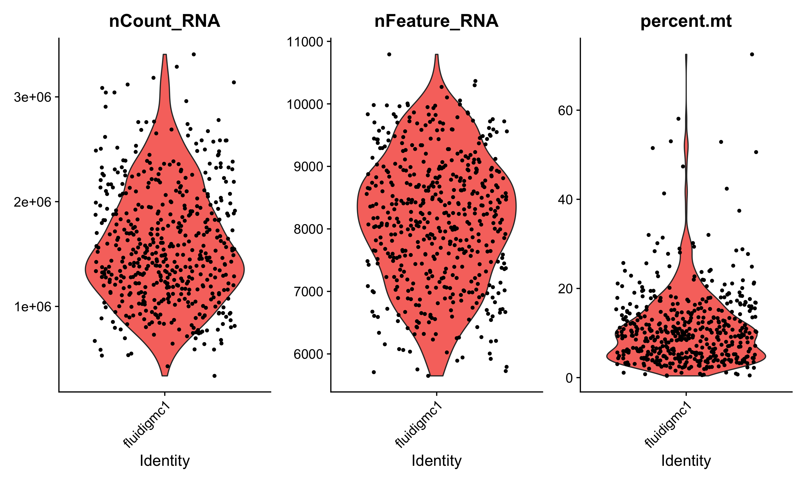
There are many quality control filters for genes and cells
We filter cells based on technical or biological parameters.
# reads or UMIs detected in a cell
# genes detected in a cell
% mito expression in a cell

Slide 9
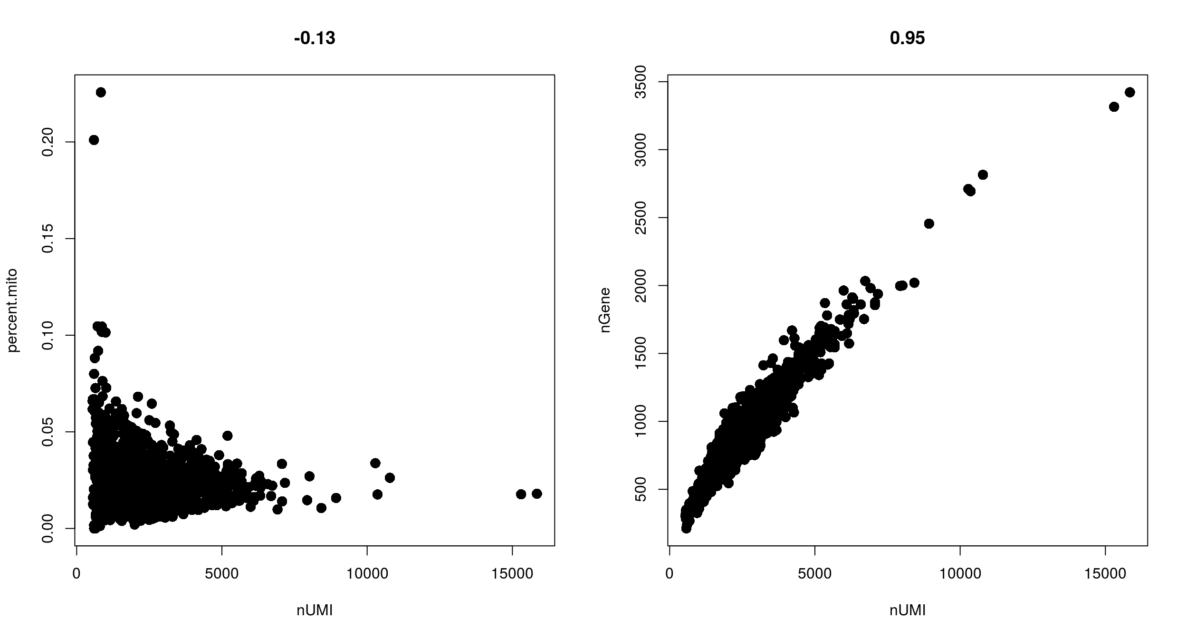
Filtering with combinations of quality control filters
Low nUMI and high % mitochondrial- Cells captured but lost a lot of the mRNA, and the mitochondrial genes were protected and retained
High nUMI & low nGene ratio – low quality library or capture rate
nGene
% mito
High nUMI & high nGene – doublets
nUMI
nUMI
Notes:
Cells got raptured and lost a lot of the mRNA, but the mitochondrial genes are protected (0.1, 10000)
Add black dot on the right

Slide 10
Appropriate quality control filters vary with platform and
cell types
Different platforms set different expectations
e.g. Smart-Seq2 often yields more genes detected per cell than 10x Chromium.
Different cell types set different expectations
Immune cells normally have fewer genes detected per cell than non-immune cells
Malignant cells normally have more genes detected per cell than non-malignant cells
Notes:
Malignant cells are more transcriptional active

Slide 11
Detecting cell doublets with Scrublet
Scrublet (Single-Cell Remover of Doublets)
Wolock, Lopez, Klein. Cell Systems 8.4 (2019): 281-291.
Notes:
Finally, we do another step of processing to distinguish droplets that contain a single cell from those droplets that contain two or more cells. The latter are not useful, especially as one of our main goals is to identify cell-type specific eQTLs and these doublets do not represent a real cell type.

Slide 12
Detecting cell doublets with Scrublet
Wolock, Lopez, Klein. Cell Systems 8.4 (2019): 281-291.

Slide 13
Detecting empty drops containing ambient RNA – manual
Look for transcripts expressed in unexpected cell types and remove those genes from all subsequent analysis
e.g. hemoglobin gene expressed in a T cell

Slide 14
Detecting empty drops containing ambient RNA – automatic
EmptyDrops (distinguish cells from empty droplets)
Cells ranked by total
unique molecular identifiers (UMI)
10000
1000
100
10
Cell encapsulated in droplet
Total UMI detected per cell
Mixture
Ambient RNA encapsulated in droplet
Lun, A.T.L. et al. Genome Biol (2019). 20, 63.

Slide 15
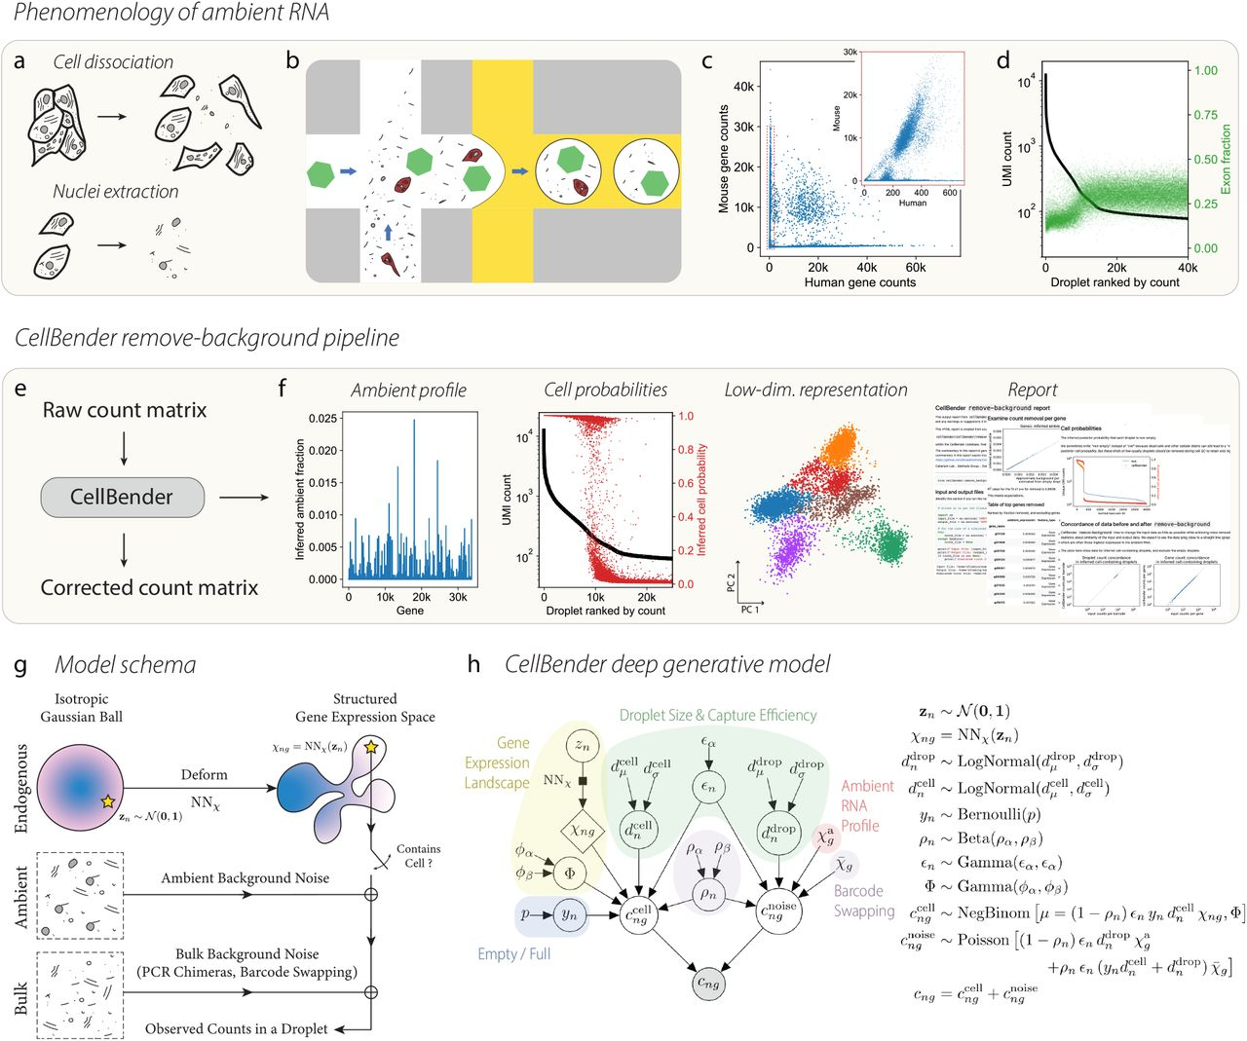
Further quality control to correct for ambient RNA
Cells ranked by total
unique molecular identifiers (UMI)
CellBender is a deep generative model of background-contaminated counts
correct ambient RNA and barcode swapping
detect empty droplets
10000
1000
100
10
Cell encapsulated in droplet
Total UMI in cell
Mixture
Ambient RNA encapsulated in droplet
Fleming S. J. et al. bioRxiv (2022).

Slide 16
Removing ambient RNA using CellBender in COVID-19 tissue
CellBender applied to COVID-19 lung tissue
CellBender qualitative observations
cell subsets become more distinct
cell type marker genes become more specific
can lower UMI and gene cutoffs, allowing for significantly more recovery of lymphocytes
Delorey T. et al. Nature (2021).
Notes:
SFTPA1 in AT2 cells

Slide 17
Quality control tips
We often revisit quality control decisions multiple times when analyzing data.
Start with permissive thresholds when filtering and investigate the effects of these thresholds before applying more stringent thresholds.
If the distributions of QC metrics differ between samples, thresholds should be determined separately for each sample to account for sample quality differences.
Visualize QC metrics per cell subset in order to flag technical biases.
Luecken M. D. et al. Molecular Systems Biology (2019) 15:e8746.

Slide 18
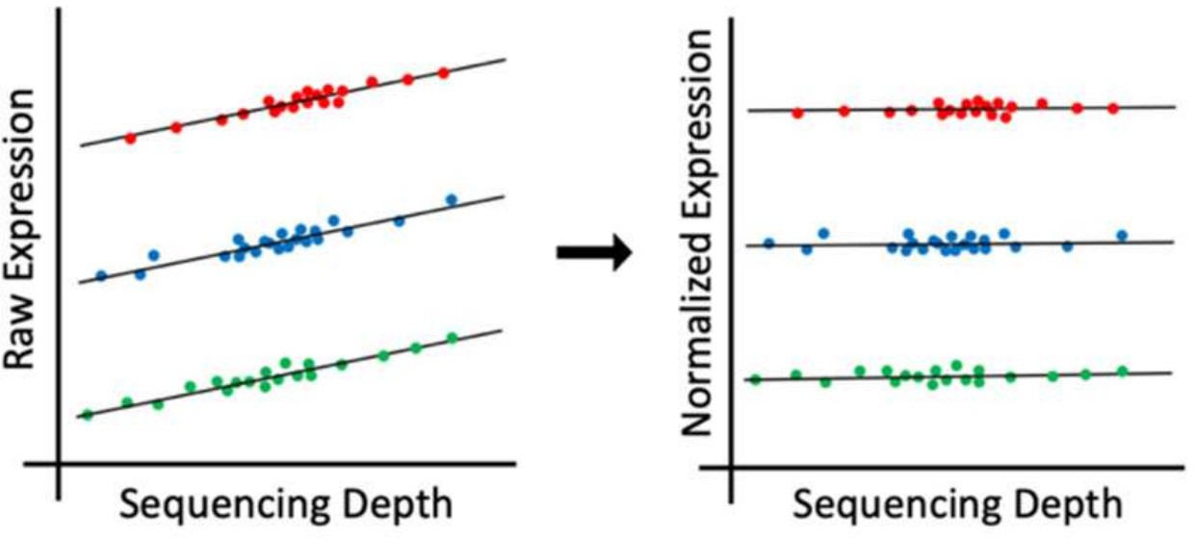
Single-cell RNA-Seq analysis: normalization
Why normalize gene expression within a cell?
Cells are sequenced to different depths (total number of molecules sequenced).
There are typically extreme values in distribution of gene expression
cell type 1
cell type 2
cell type 3
Differences in sequencing depth can lead to false differences in gene expression.

Slide 19
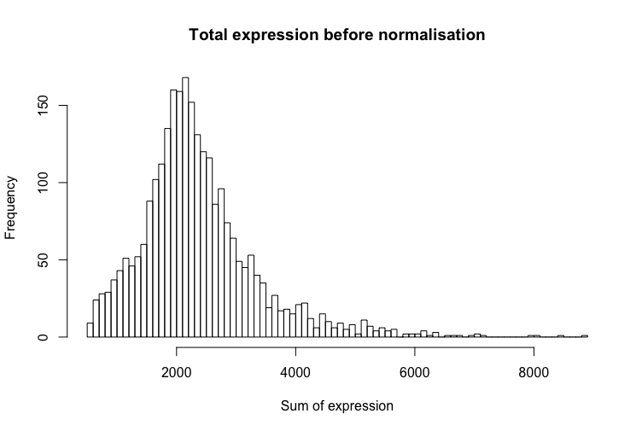
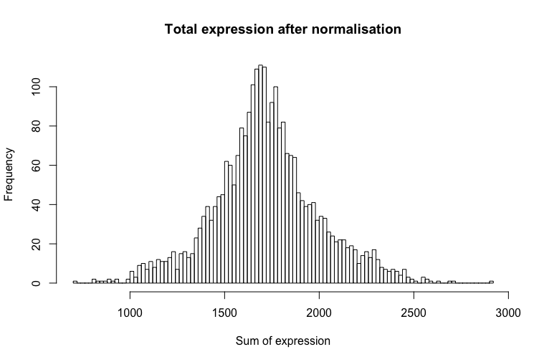
Single-cell RNA-Seq analysis: normalization
The goal of normalization is for differences in normalized read counts to represent differences in true expression.
Common normalization approach
Gene expression measurements for each cell are normalized by the total gene expression.
Gene expression values are next scaled to sum to 10,000 and then log(1+x)-transformed.
hbctraining.github.io/main
Notes:
Next we carry our normalization within each single cell. The total gene expression within a cell is the sum of the expression levels of all genes in the cell, and due to technical reasons, the total gene expression across individual cells often varies a lot. This is a confounding factor in analysis.

Slide 20
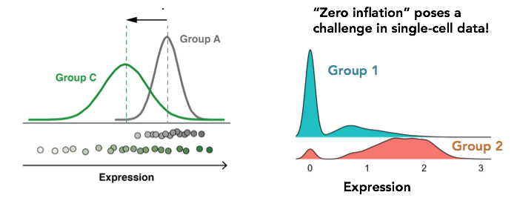
Is standard normalization appropriate?
Reassessing the idea that droplet scRNA-Seq is zero-inflated.
“Droplet scRNA-seq is not zero-inflated.” Svensson, Nature Biotechnology (2020)
”Feature selection and dimension reduction for single-cell RNA-Seq based on a multinomial model.” Townes et al. Genome Biology (2019)
“Normalization and variance stabilization of single-cell RNA-seq data using regularized negative binomial regression.” Hafemeister et al. Genome Biology (2019)
Single
cell
Bulk

Slide 21
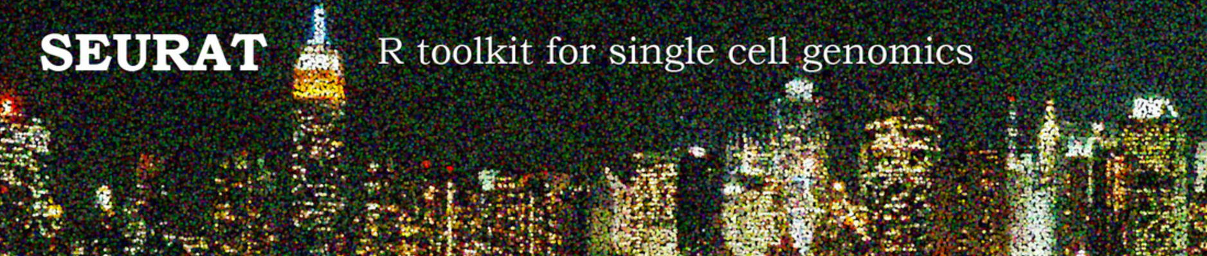
Interacting with Seurat objects
Seurat object is used for to store 10x data and perform analysis
Count matrices for different assays are stored (gene expression, protein expression, chromatin accessibility, etc…)
Counts are stored as: counts (raw), data (normalized), scaled data (centered and scaled) in sparse matrices when possible
Metadata describes individual cells and genes
Functions for analysis (quality control, normalization, feature selection, dimensional reduction, cell-cell distances, unsupervised clustering)
https://github.com/satijalab/seurat/wiki
https://satijalab.org/seurat/essential_commands.html

Slide 22
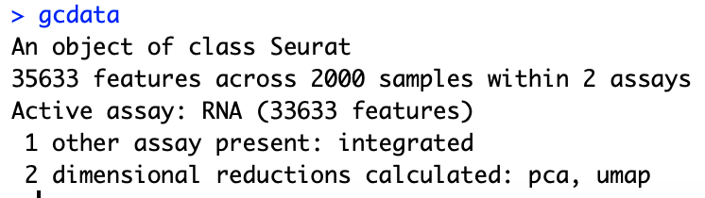
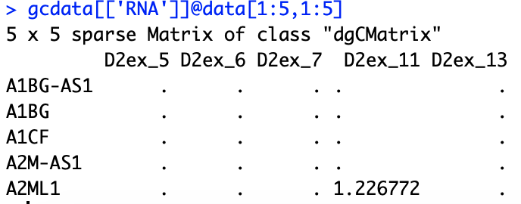
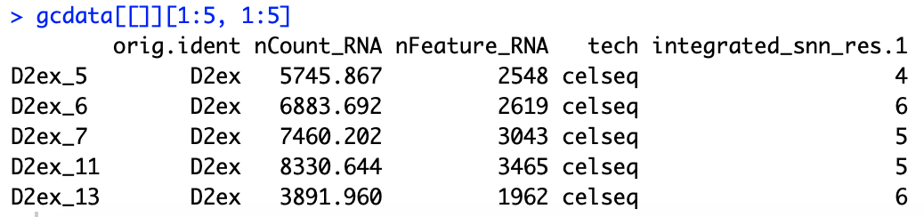
Interacting with Seurat objects
Seurat object
Accessing count slot from RNA assay
Accessing cell metadata
Running analysis function

Slide 23
Loading data into a Seurat object
gcdata <- CreateSeuratObject(counts = celseq.data)
counts matrix

Slide 24
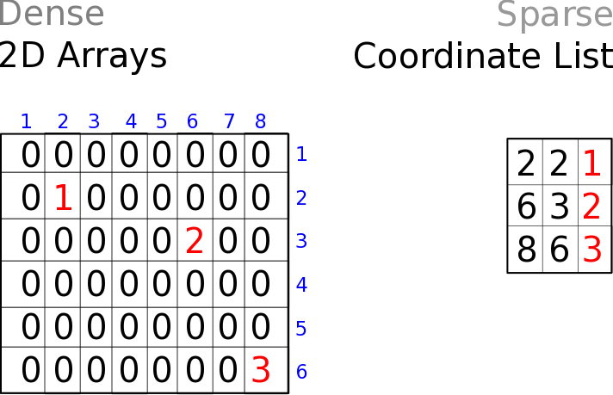
Storing counts data in dense vs sparse format
cells
genes
Dense matrices
Sparse matrices

Slide 25
Suggested reading
Reviews:
Luecken M. D. et al. Molecular Systems Biology (2019) 15:e8746.
Kiselev C. et al. (2019) Nature Reviews Genetics. 20: 273-282.
Tutorials:
https://satijalab.org/seurat/articles/pbmc3k_tutorial
https://scanpy.readthedocs.io/en/stable/tutorials/basics/clustering.html
Software:
Single-cell analysis in R:
Seurat: https://satijalab.org/seurat/
Single-cell analysis in python:
Scverse: https://scverse.org/
scanpy: https://scanpy.readthedocs.io/en/stable/

